Slide 1
One-Chip Design
Cadence Full-Custom IC Design
B.S. YoungHyun Kim

Slide 2
INDEX
Program & Tool
Program & Tools
Digital Circuits & Analog Circuits
One Chip

Slide 3
Program & Tools
Cadence Virtuoso Schematic Editor / Layout Editor
Cadence Virtuoso Spectre / ADE
Assura(LVS & DRC)
GPDK090

Slide 4
DIGITAL CIRCUITS & ANALOG CIRCUITS
Digital Logic Gates
NOT
2NAND / 3NAND / 4NAND
2NOR / 3NOR / 4NOR
Digital Circuits
2x1 MUX / 4x1 MUX
HALF_ADDER / FULL_ADDER / 4BIT_ADDER

Slide 5
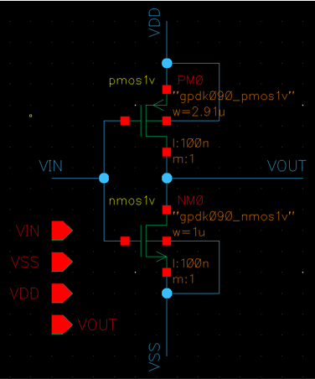
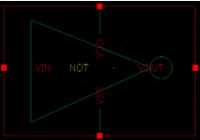
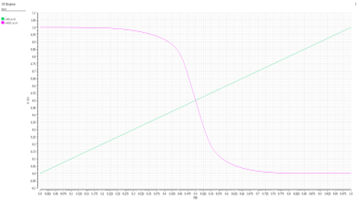
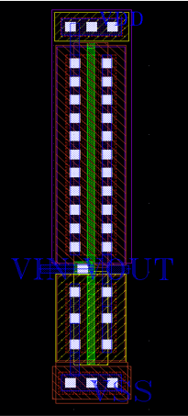
Digital Logic Gate – NOT
Schematic |  | Layout | Simulation
Symbol |  | Hight = 5.73um Width = 1.06um | Cross Vin 500mV, Vout 500mV

Slide 6
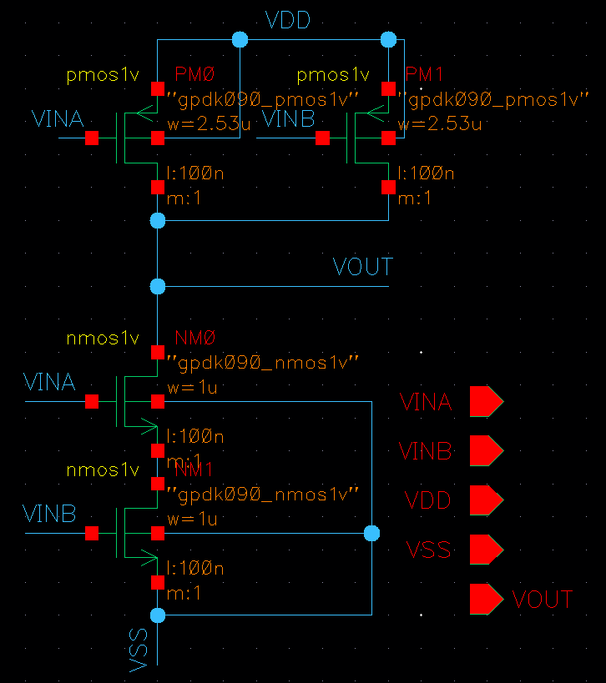
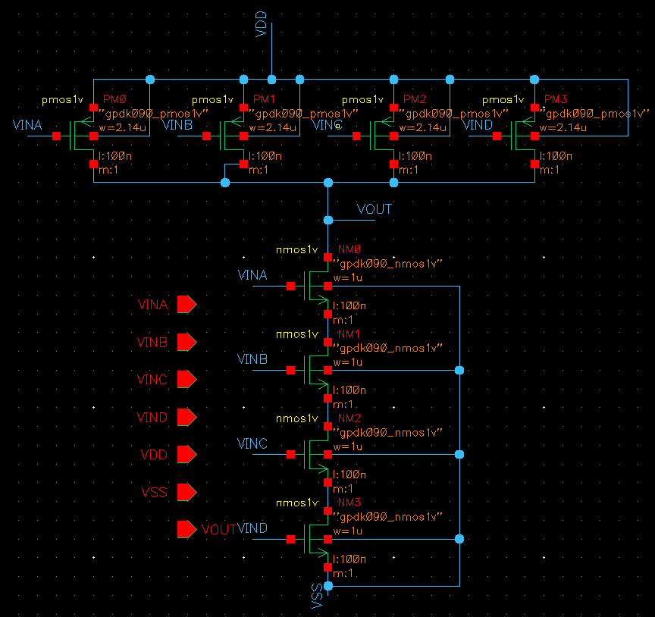
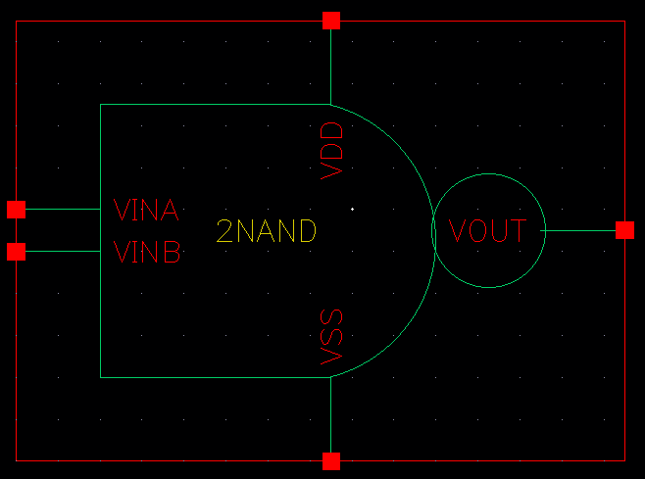
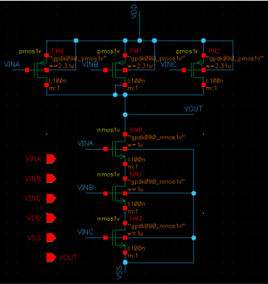
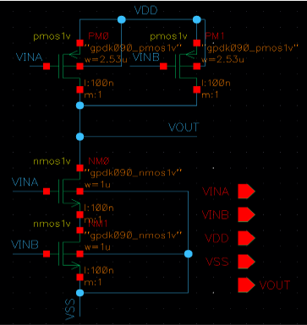
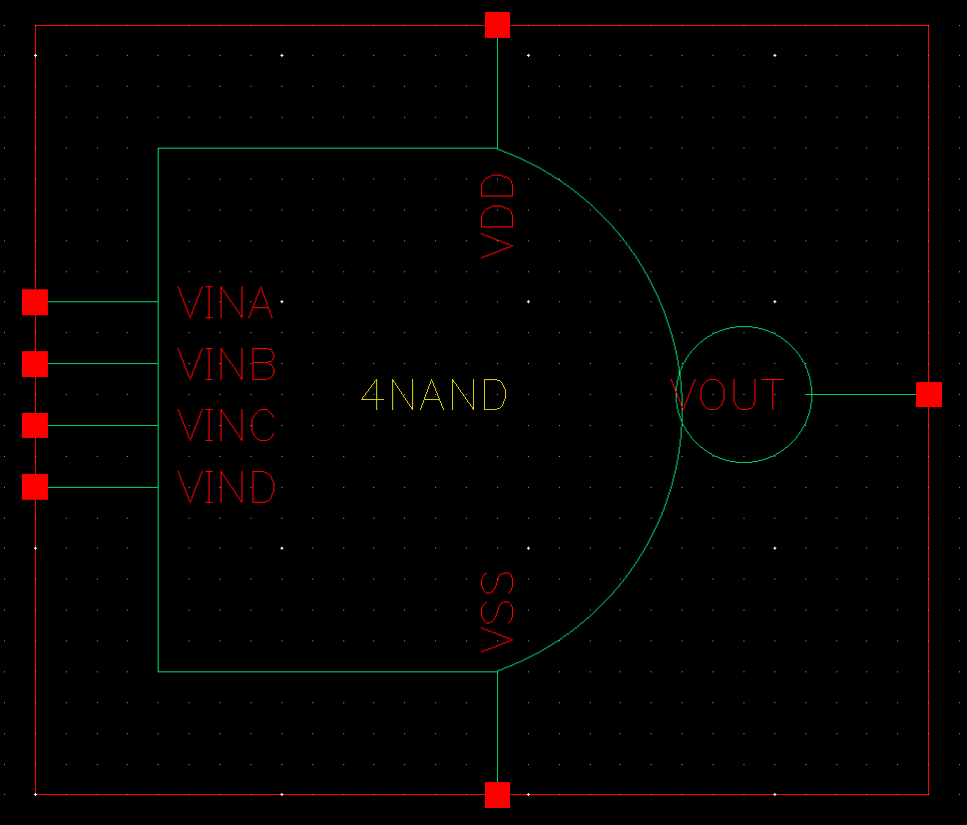
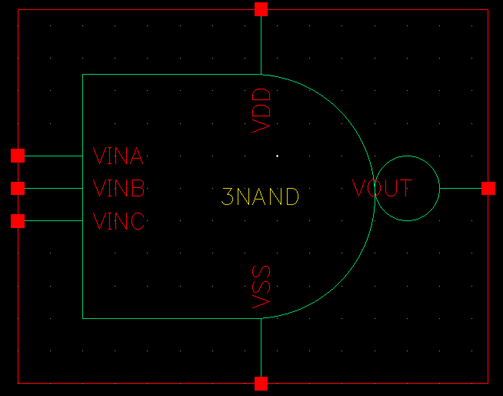
Digital Logic Gate – NAND(Schematic)
2NAND NMOS 1um PMOS 2.53um |  | 3NAND NMOS 1um PMOS 2.31um |  | 4NAND NMOS 1um PMOS 2.14um

Slide 7
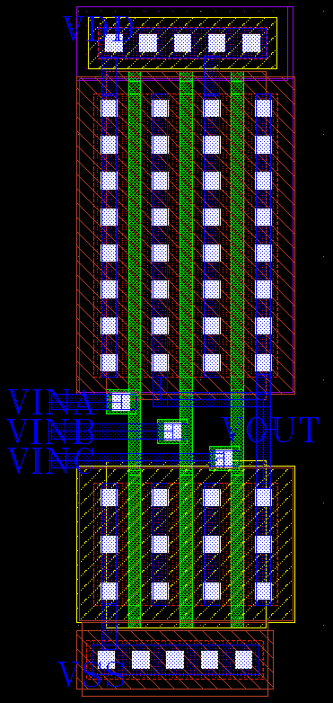
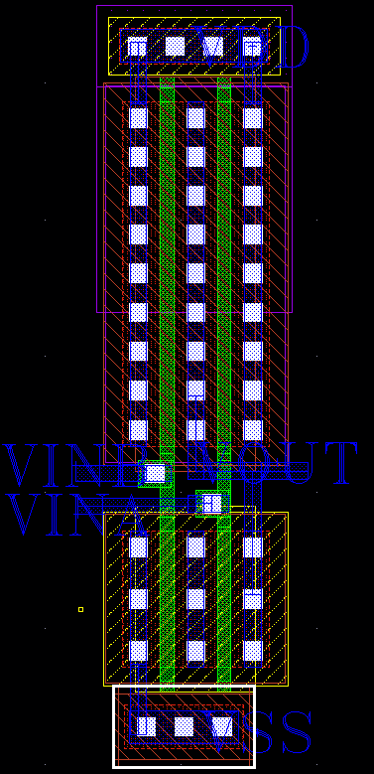
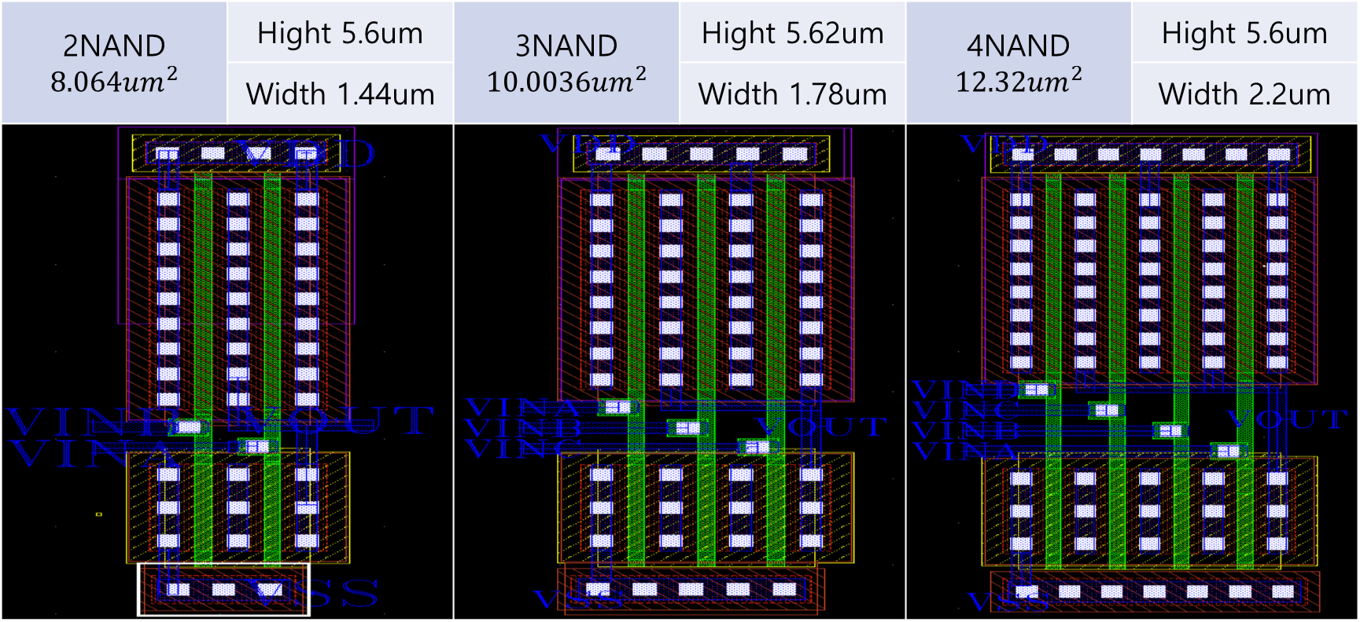
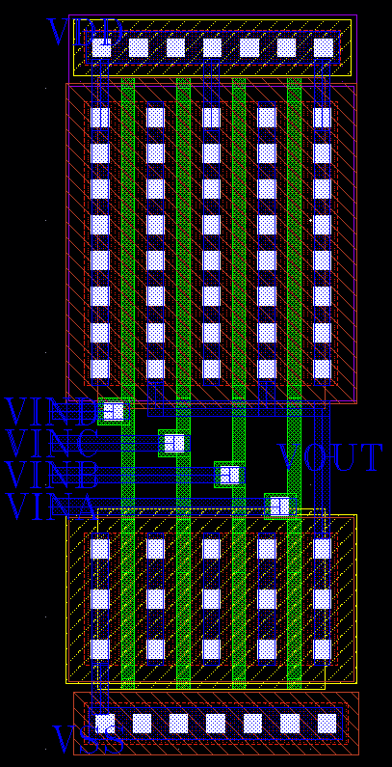
Digital Logic Gate – NAND(Layout)
2NAND $$8.064um^{2}$$ | Hight 5.6um | 3NAND $$10.0036um^{2}$$ | Hight 5.62um | 4NAND $$12.32um^{2}$$ | Hight 5.6um
 | Width 1.44um |  | Width 1.78um |  | Width 2.2um

Slide 8
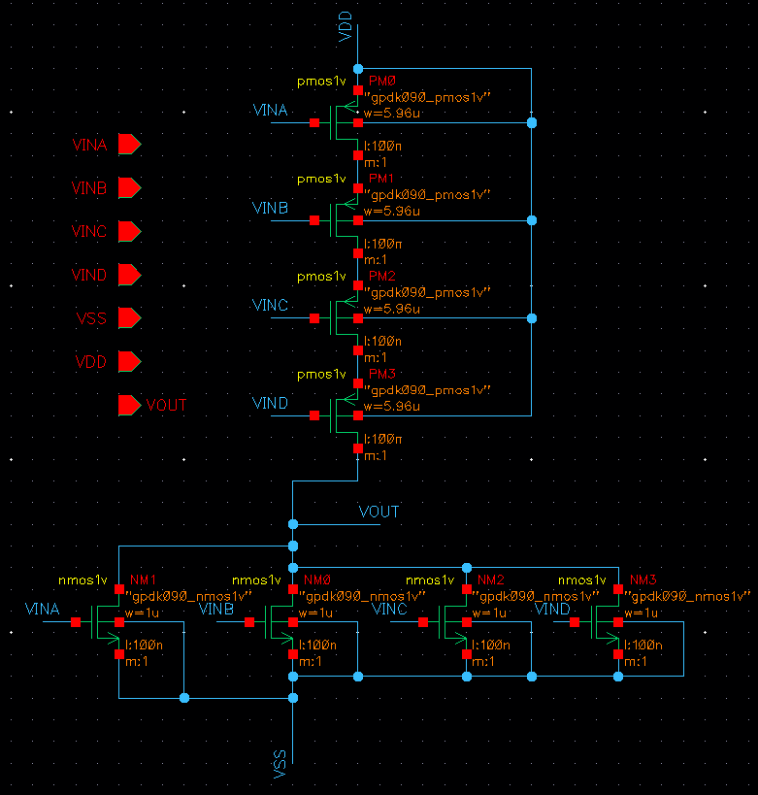
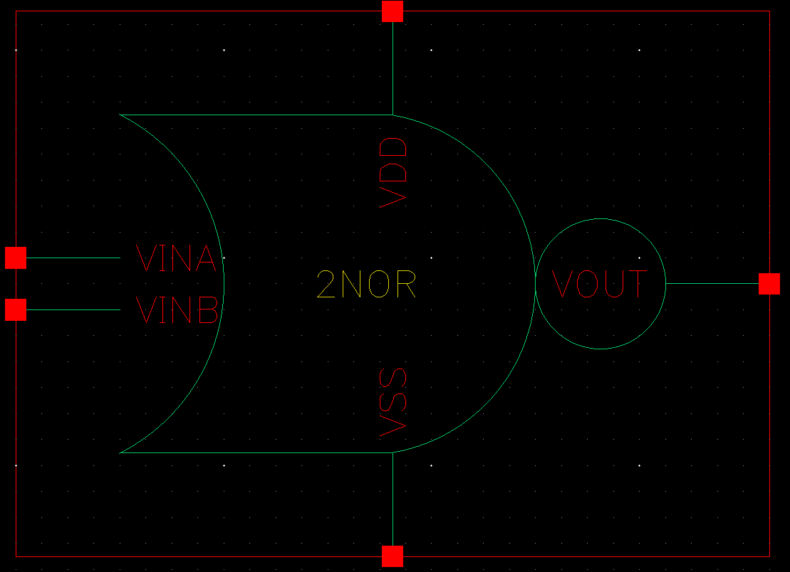
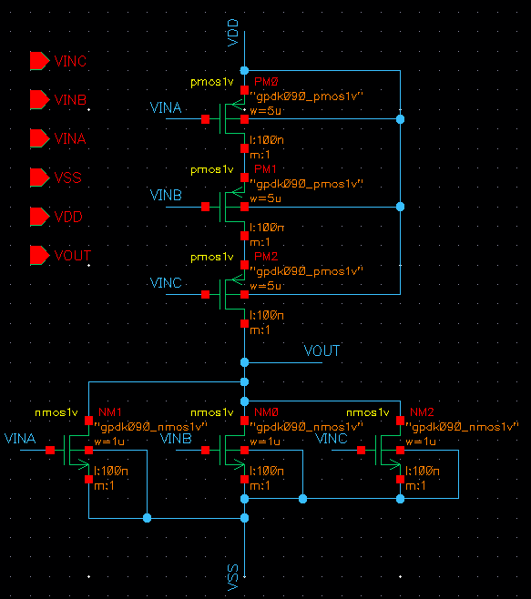
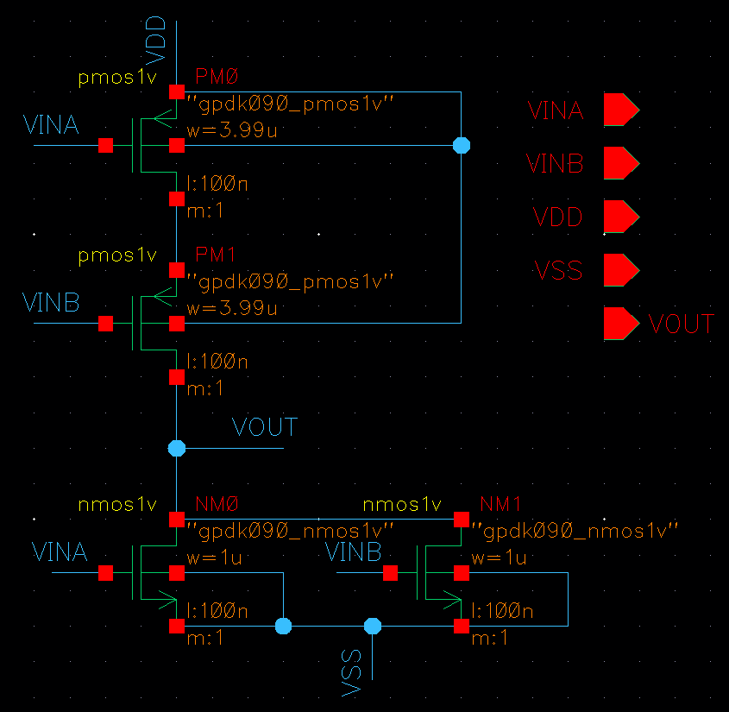
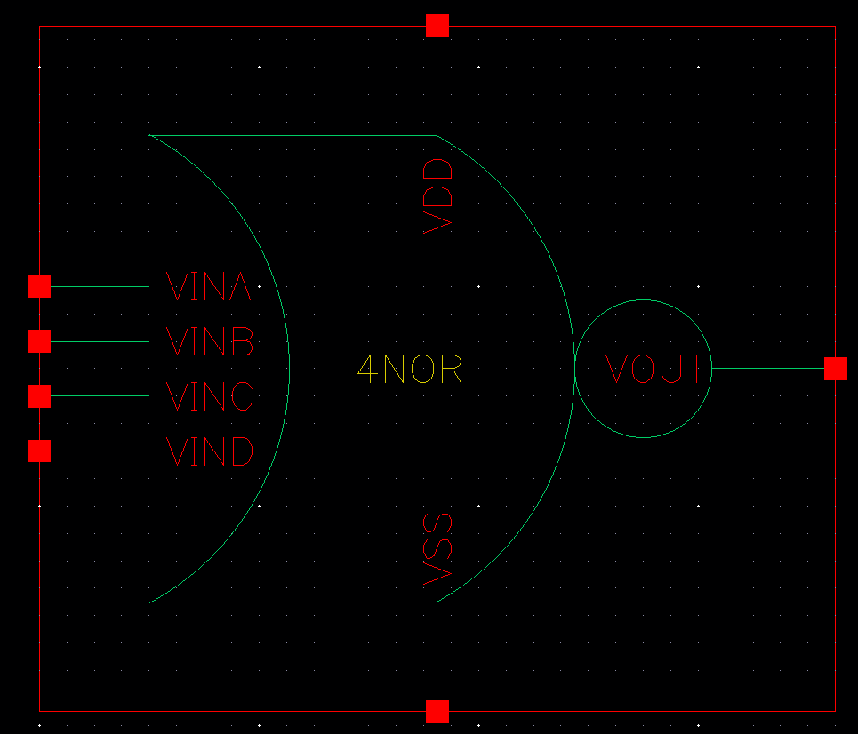
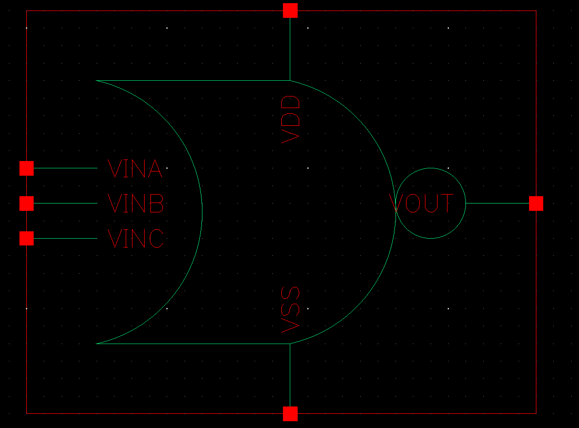
Digital Logic Gate – NOR(Schematic)
2NOR NMOS 1um PMOS 3.99um |  | 3NOR NMOS 1um PMOS 5um |  | 4NOR NMOS 1um PMOS 5.96um

Slide 9
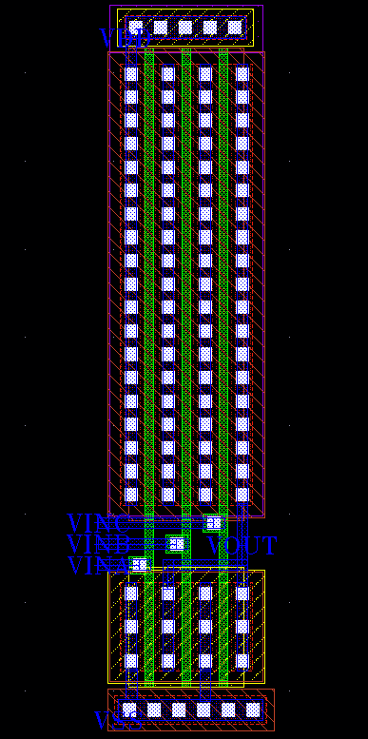
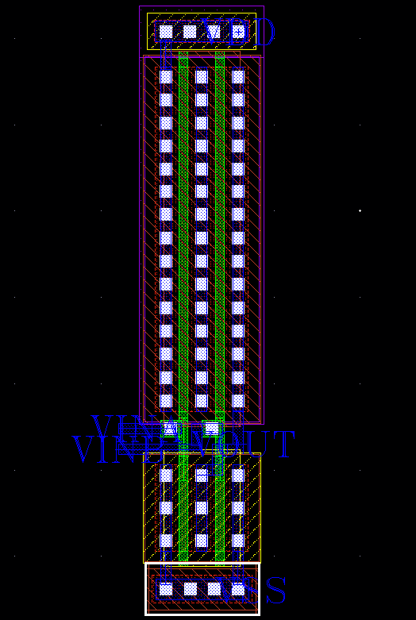
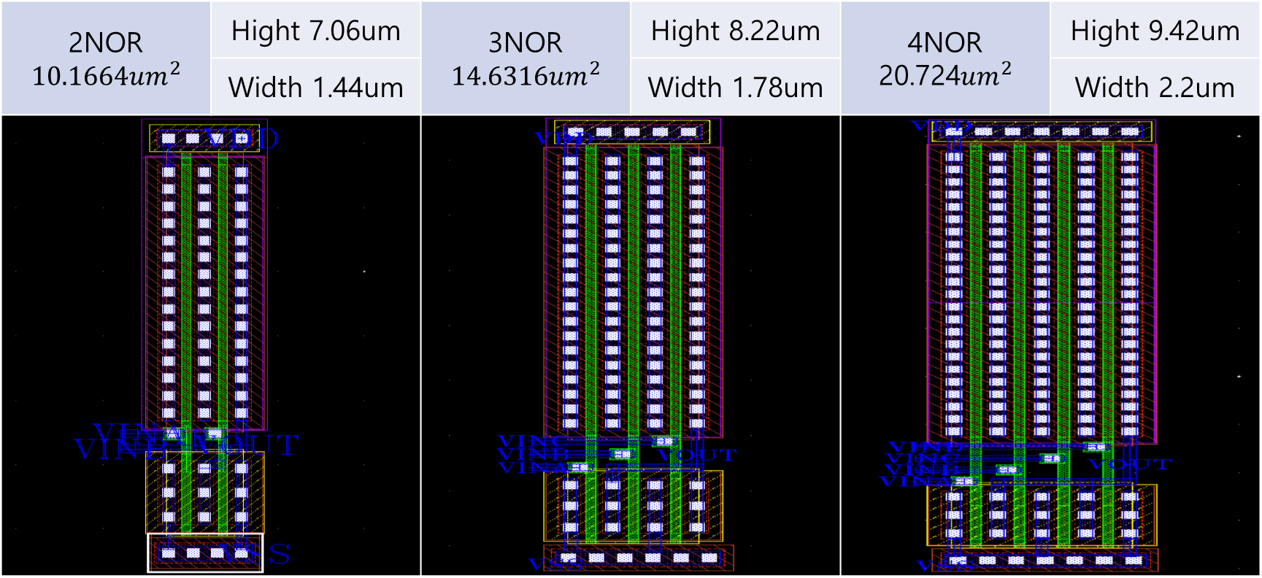
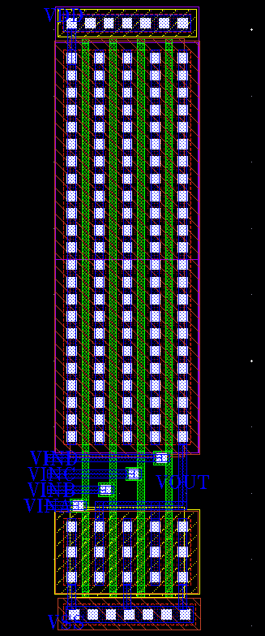
Digital Logic Gate – NOR(Layout)
2NOR $$10.1664um^{2}$$ | Hight 7.06um | 3NOR $$14.6316um^{2}$$ | Hight 8.22um | 4NOR$\text{20.724}um^{2}$ | Hight 9.42um
 | Width 1.44um |  | Width 1.78um |  | Width 2.2um

Slide 10
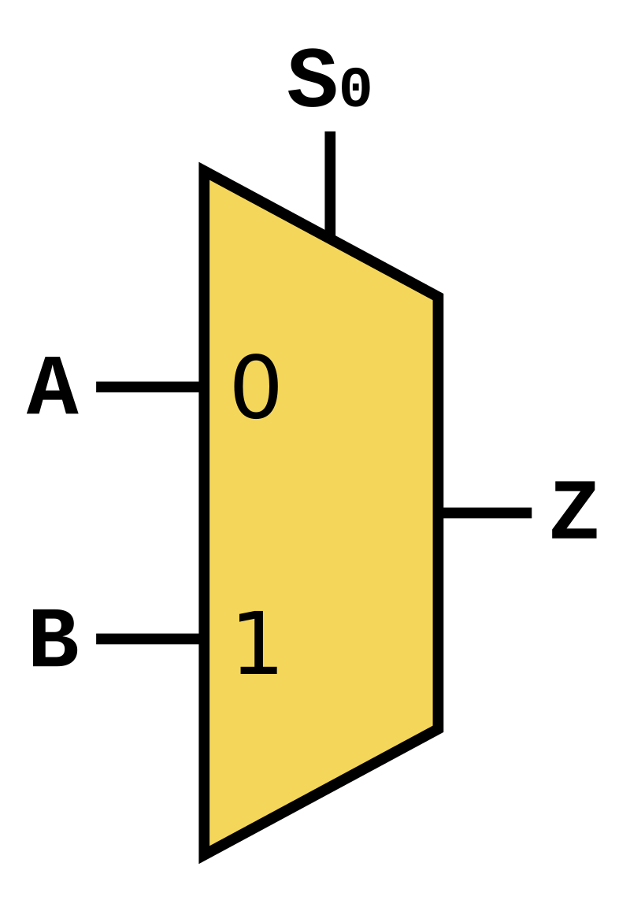
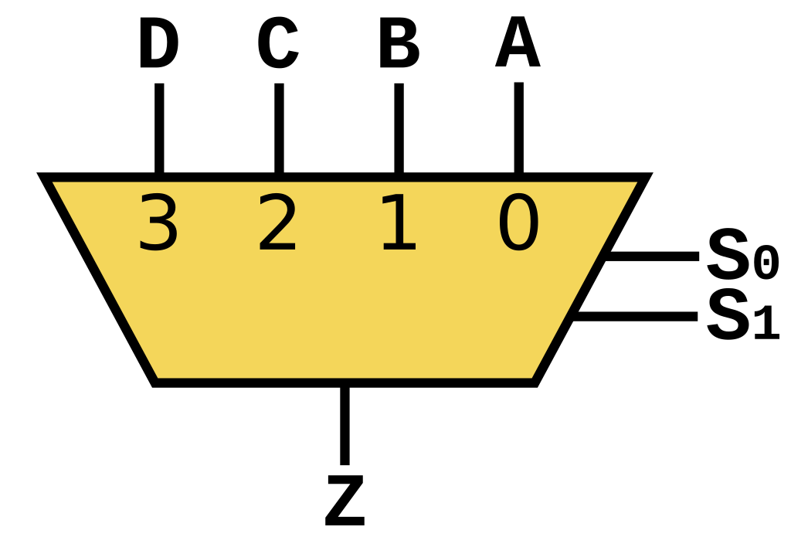
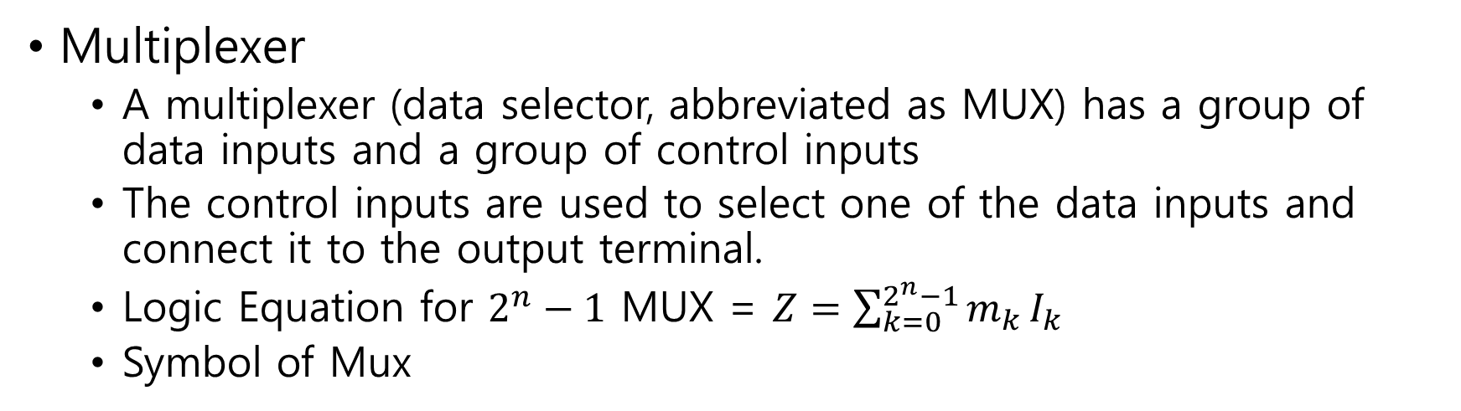
Digital Circuit – MUX
Multiplexer
A multiplexer (data selector, abbreviated as MUX) has a group of data inputs and a group of control inputs
The control inputs are used to select one of the data inputs and connect it to the output terminal.
Logic Equation for $2^{n}−1$ MUX = $Z=\sum_{k=0}^{2^{n}−1}{m_{k}}I_{k}$
Symbol of Mux

Slide 11
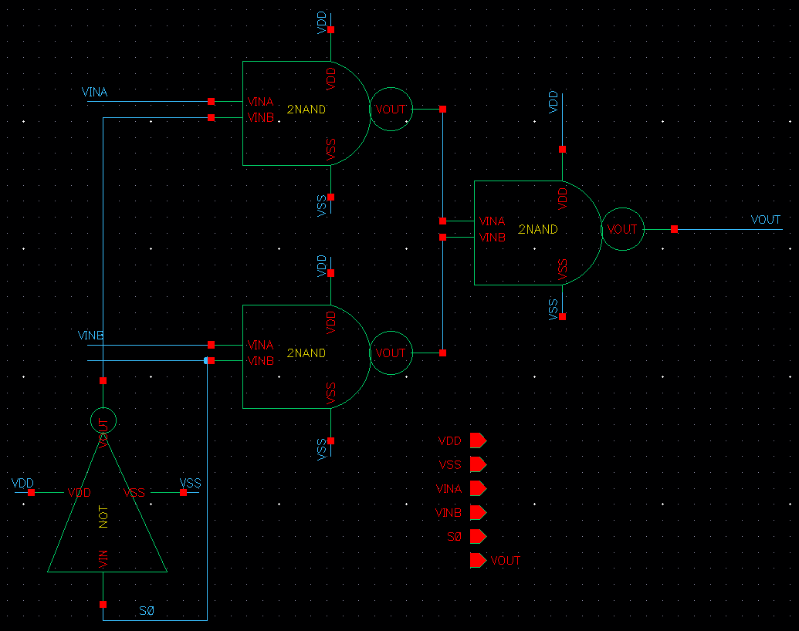
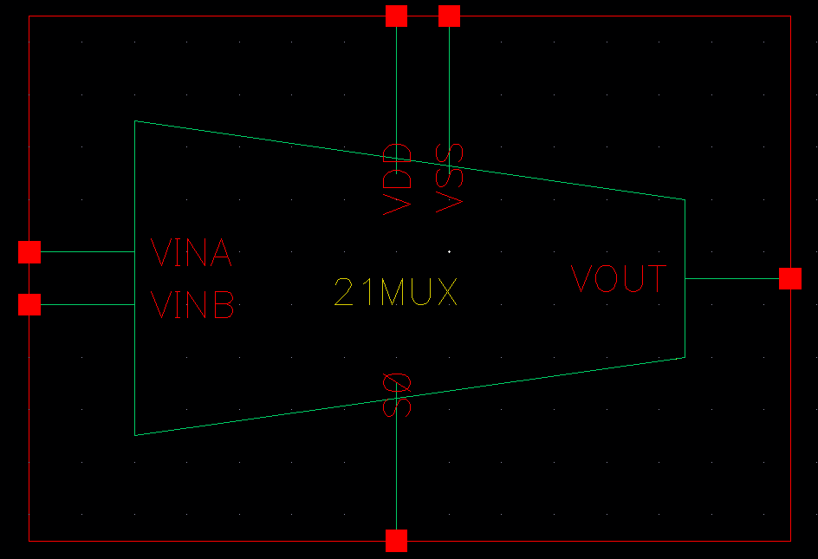
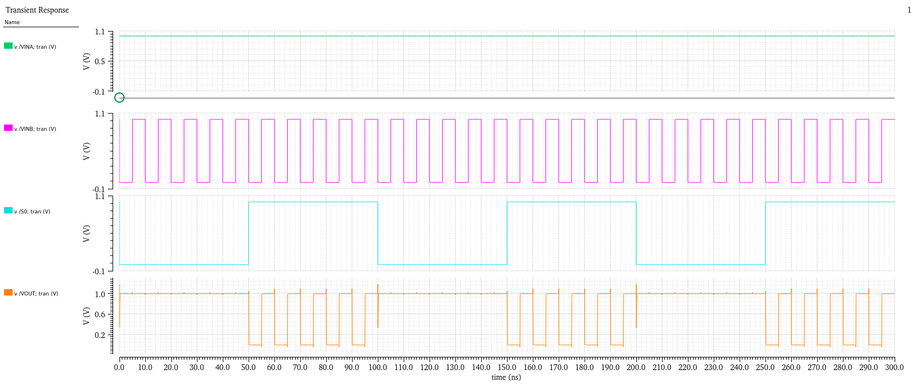
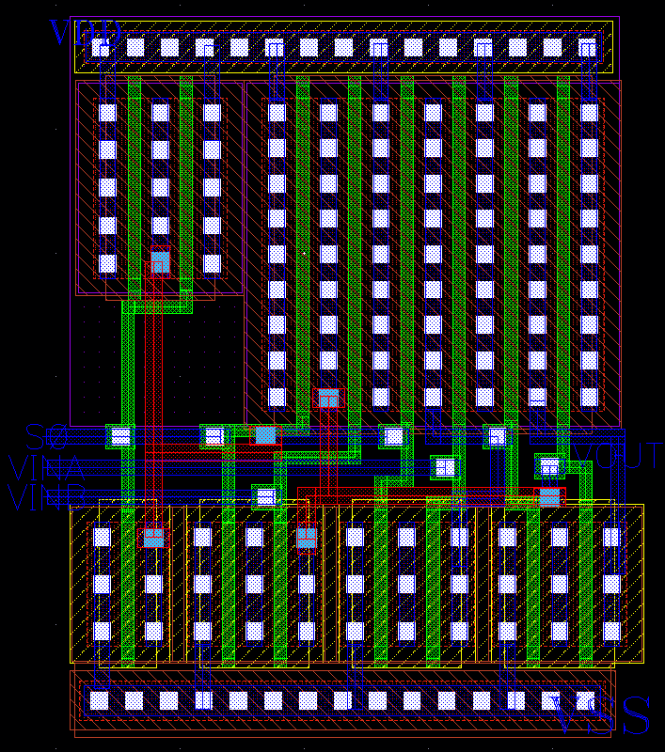
Digital Circuit – 21MUX
Schematic |  | Layout | Simulation
Symbol |  | Hight = 5.82um Width = 4.63um | S0 = 0 → Vout = VinA S0 = 1 → Vout = VinB

Slide 12
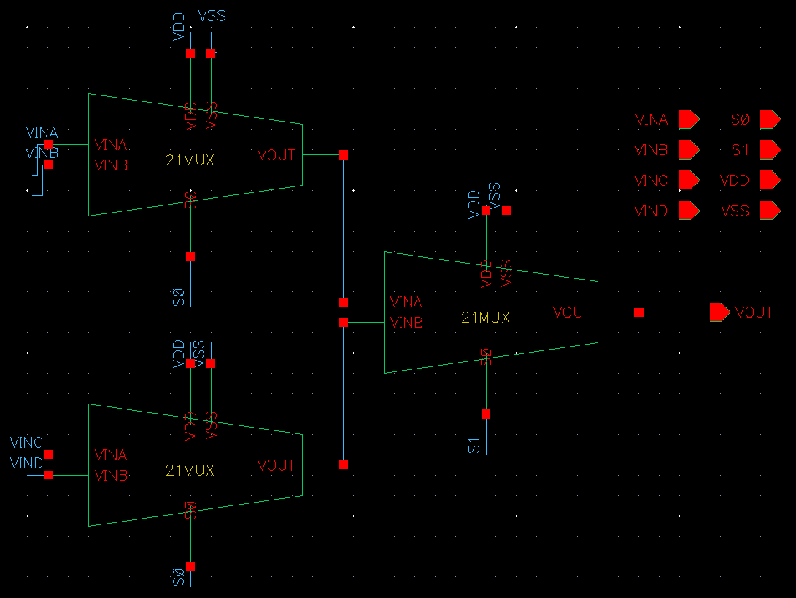
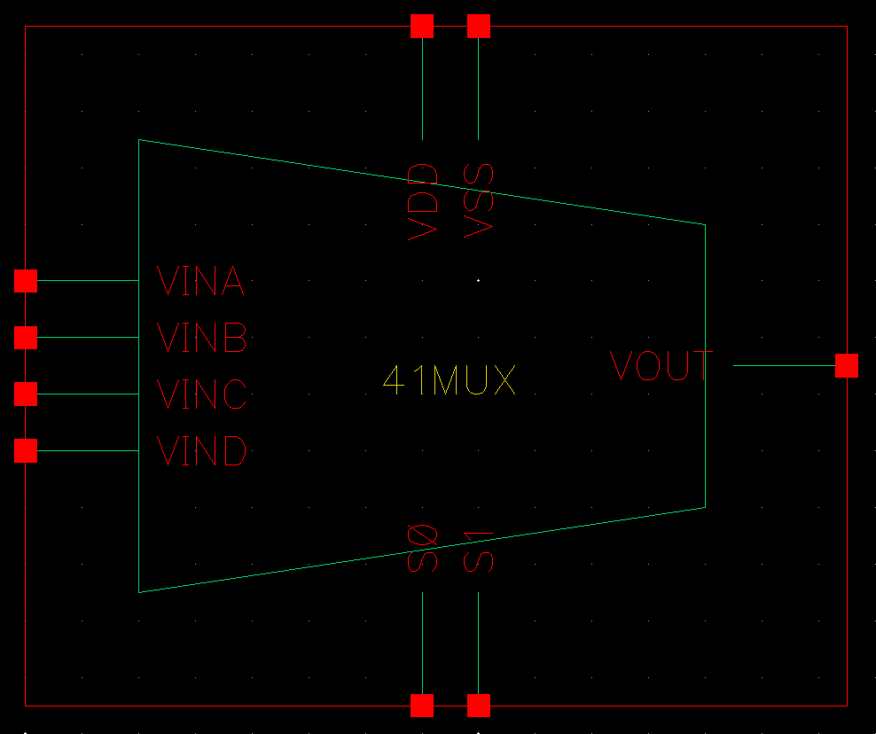
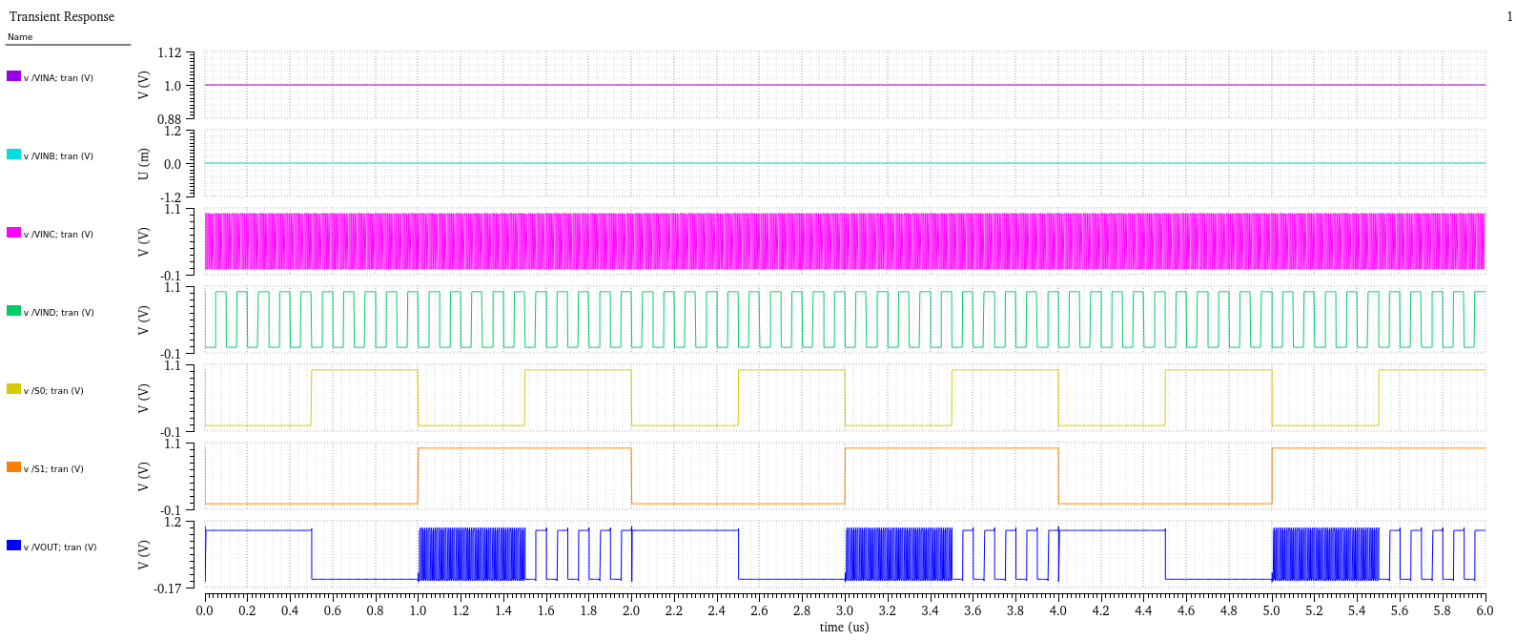
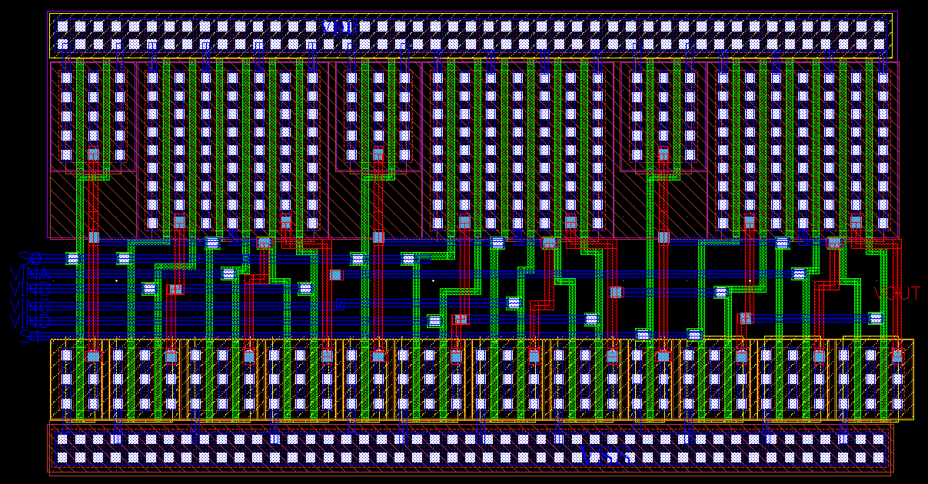
Digital Circuit – 41MUX
Schematic |  | Layout | Simulation
Symbol |  | Hight = 7.35um Width = 13.63um | S1S0 = 00 → Vout = VinA S1S0 = 01 → Vout = VinB S1S0 = 10 → Vout = VinC S1S0 = 11 → Vout = VinD

Slide 13
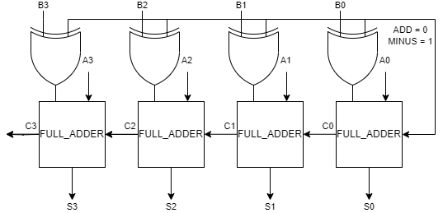
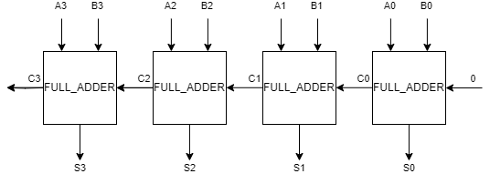
Digital Circuit – ADDER
ADDER
HALF_ADDER
Carry = AB / Sum = A⊕B
FULL_ADDER
Carry = AB + (A⊕B)Cin / Sum = (A⊕B)⊕Cin
4BIT_ADDER
4 * FULL_ADDER
4BIT_ADDER_SUBTRACTOR
4 * XOR & 4 * FULL_ADDER
Notes:
HALF_ADDER / FULL_ADDER / 4BIT_ADDER

Slide 14
Digital Circuit – ADDER
HALF_ADDER
Carry = AB
Sum = A⊕B
Truth Table
Input |  | Output
A | B | Sum | Carry
0 | 0 | 0 | 0
0 | 1 | 1 | 0
1 | 0 | 1 | 0
1 | 1 | 0 | 1
Digital circuit used in electronics for adding two single-bit binary numbers.
It takes two binary inputs and produces two outputs: sum and carry.
Notes:
HALF_ADDER / FULL_ADDER / 4BIT_ADDER

Slide 15
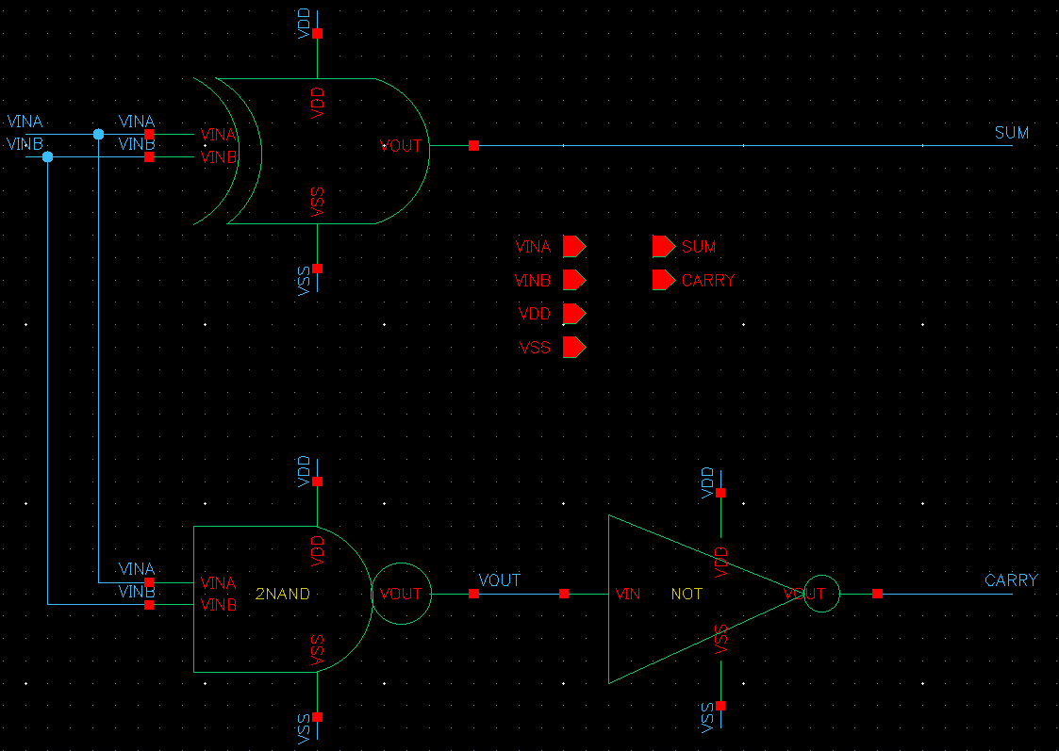
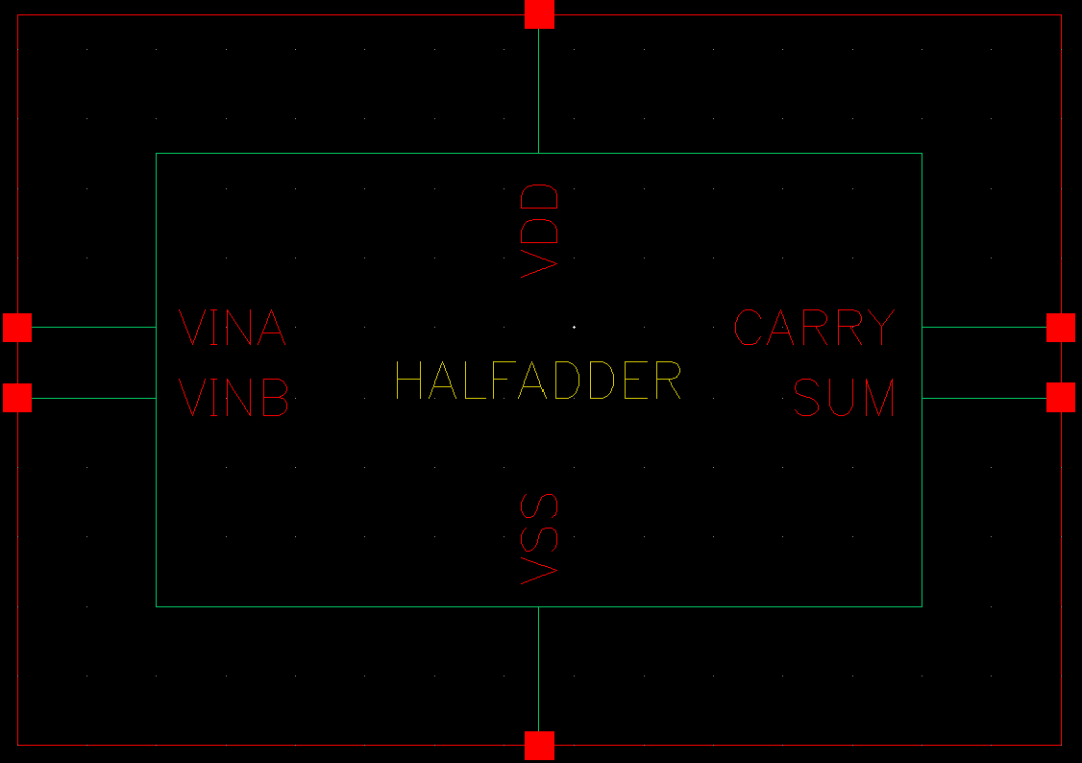
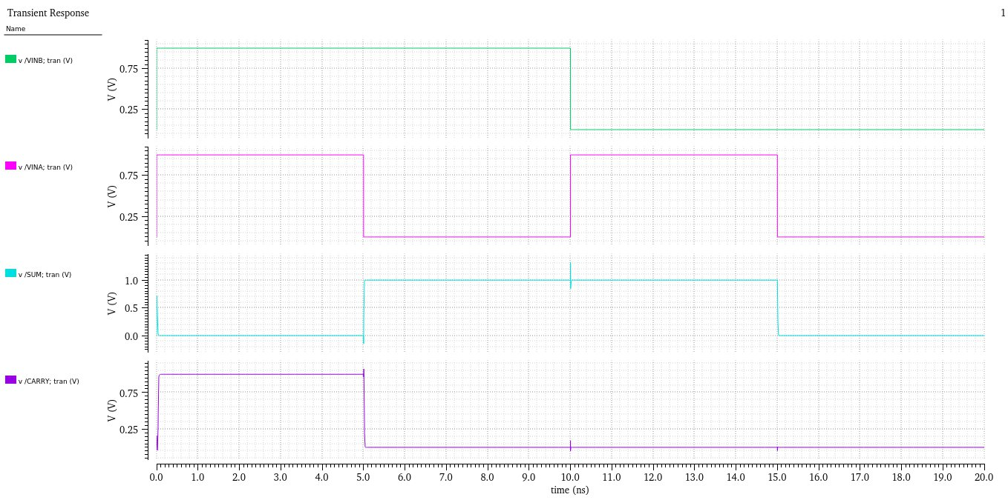
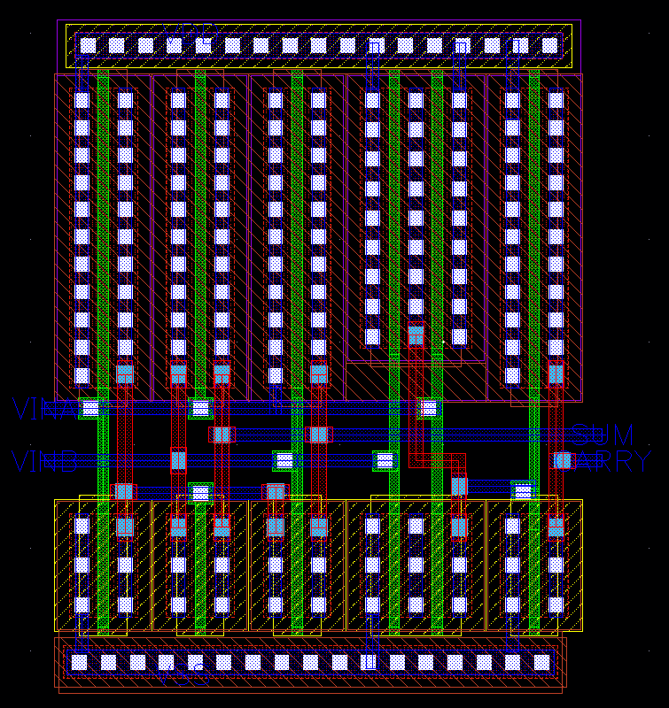
Digital Circuit – HALF_ADDER
Schematic |  | Layout | Simulation
Symbol |  | Hight = 5.53um Width = 5.12um | A=1,B=1 → SUM 0 CARRY 1 A=0,B=1 → SUM 1 CARRY 0 A=1,B=0 → SUM 1 CARRY 0 A=0,B=0 → SUM 0 CARRY 0

Slide 16
Digital Circuit – ADDER
FULL_ADDER
Carry = AB + (A⊕B)Cin
Sum = (A⊕B)⊕Cin
Digital circuit used for adding three single-bit binary numbers.
Full adder handles an additional carry input from a previous addition stage.
Truth Table
Input |  |  | Output
A | B | C | Sum | Carry
0 | 0 | 0 | 0 | 0
0 | 0 | 1 | 1 | 0
0 | 1 | 0 | 1 | 0
0 | 1 | 1 | 0 | 1
1 | 0 | 0 | 1 | 0
1 | 0 | 1 | 0 | 1
1 | 1 | 0 | 0 | 1
1 | 1 | 1 | 1 | 1
Notes:
HALF_ADDER / FULL_ADDER / 4BIT_ADDER

Slide 17
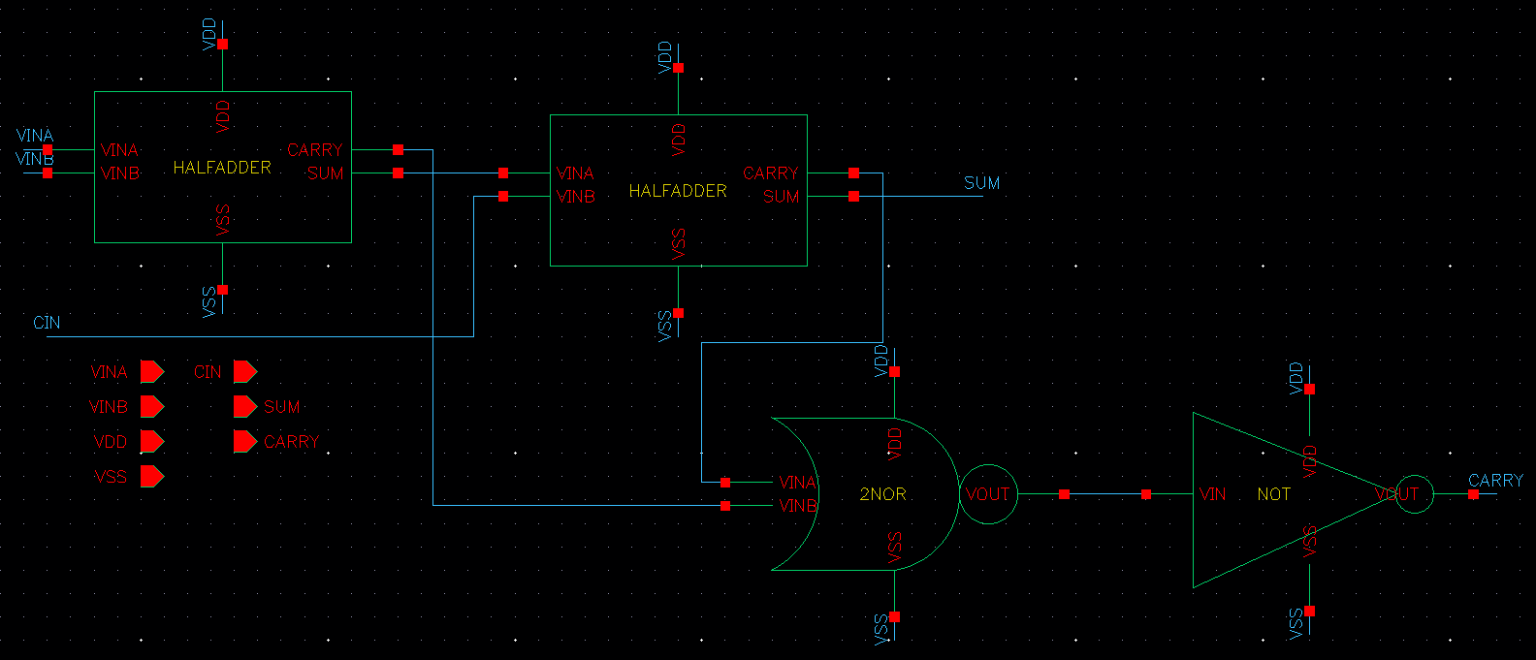
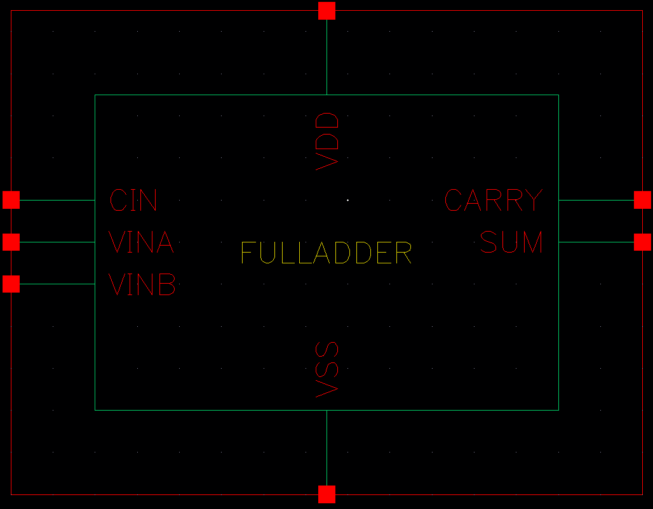
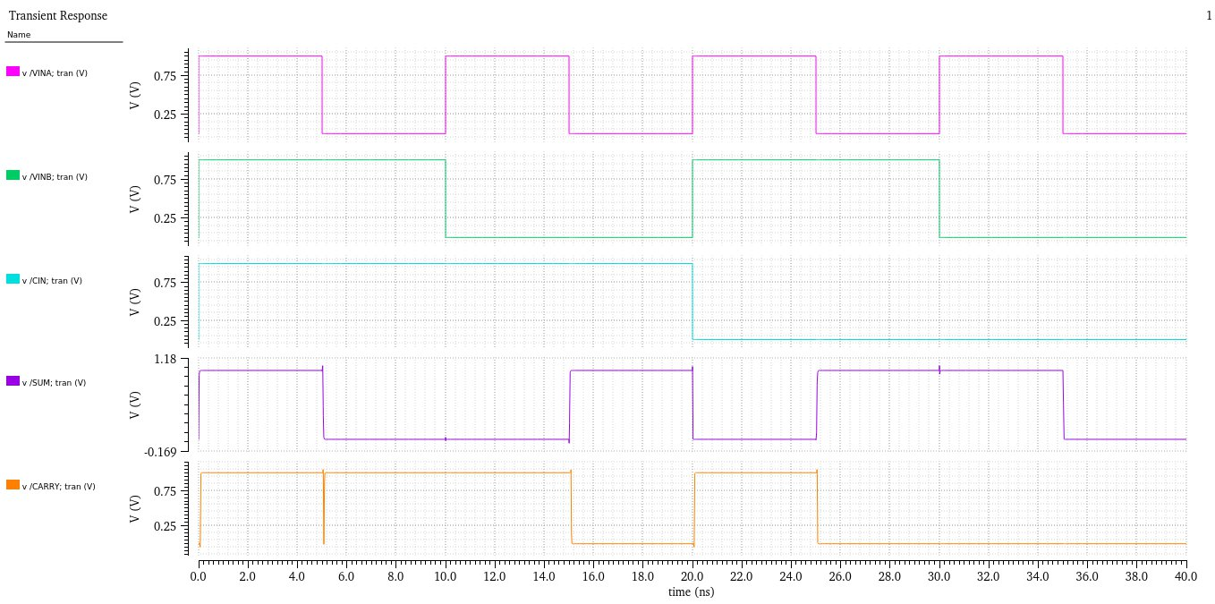
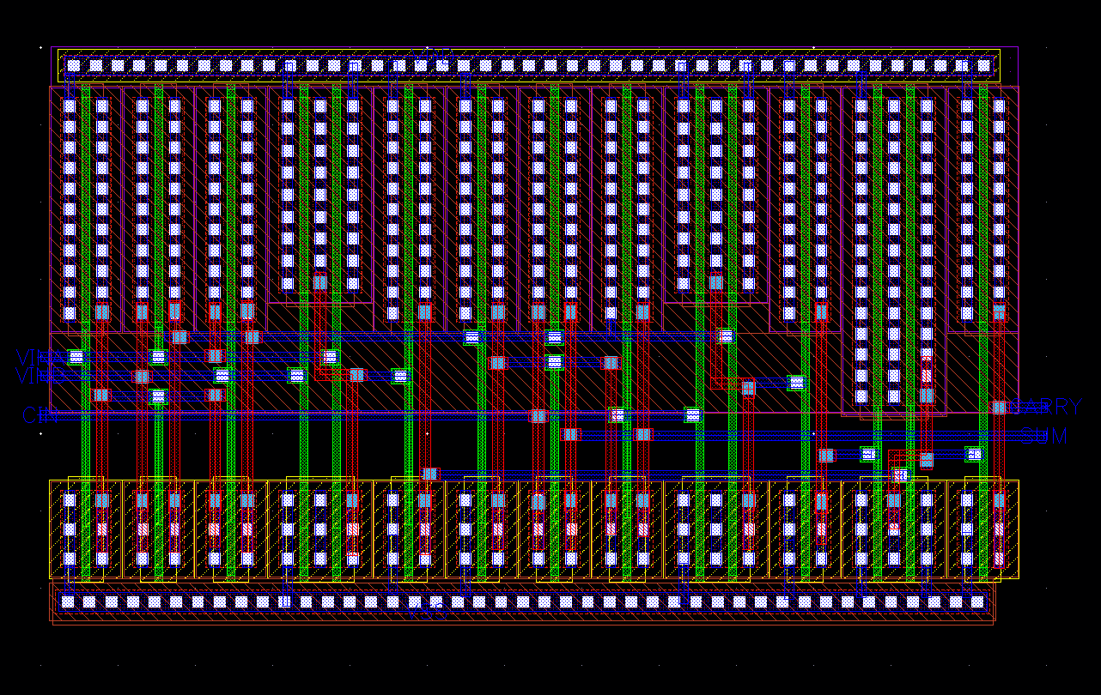
Digital Circuit – FULL_ADDER
Schematic |  | Layout | Simulation
Symbol |  | Hight = 7.49um Width = 12.54um | A=1,B=1,C=1 → SUM 1 CARRY 1 A=0,B=1,C=1 → SUM 0 CARRY 1 A=1,B=0,C=1 → SUM 0 CARRY 1 A=0,B=0,C=1 → SUM 1 CARRY 0

Slide 18
Digital Circuit – ADDER
4BIT_ADDER
Adds two 4-bit binary numbers and produces a sum along with a carry-out.
Composed of multiple full adders arranged in a sequence
Examples
Input |  | Output
A | B | Sum | Carry
1011 | 0110 | 0001 | 1
1010 | 0101 | 1111 | 0
0010 | 0111 | 1001 | 0
Notes:
HALF_ADDER / FULL_ADDER / 4BIT_ADDER

Slide 19
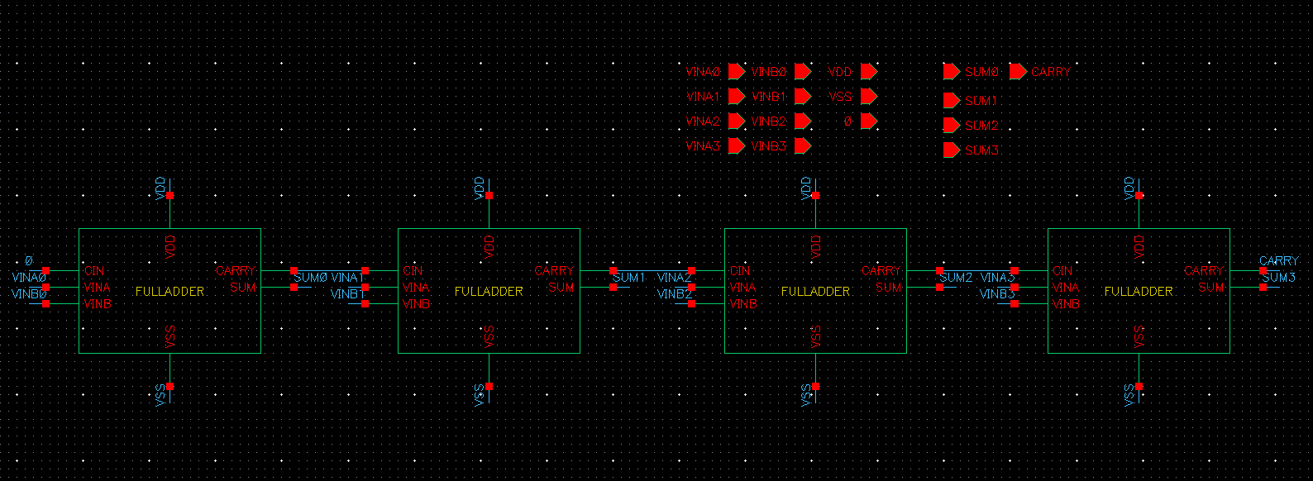
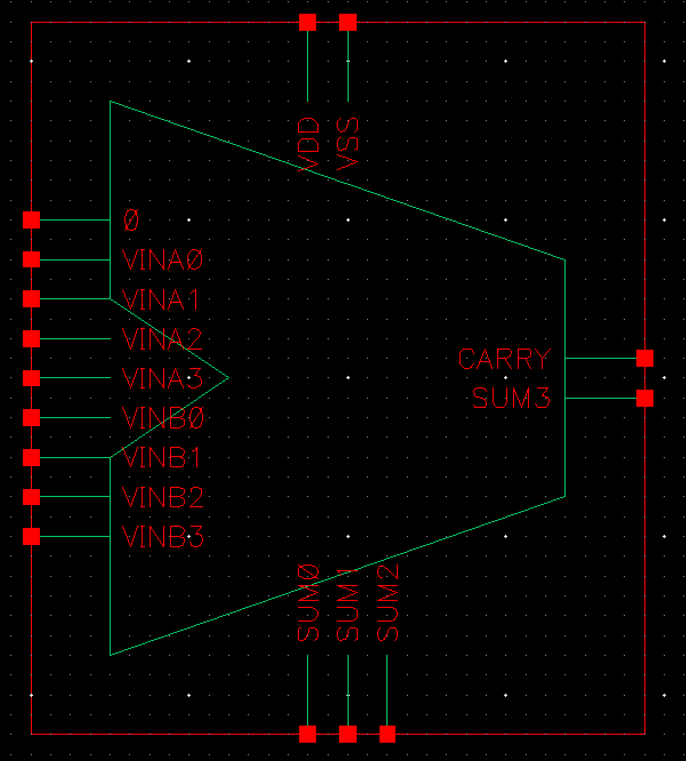
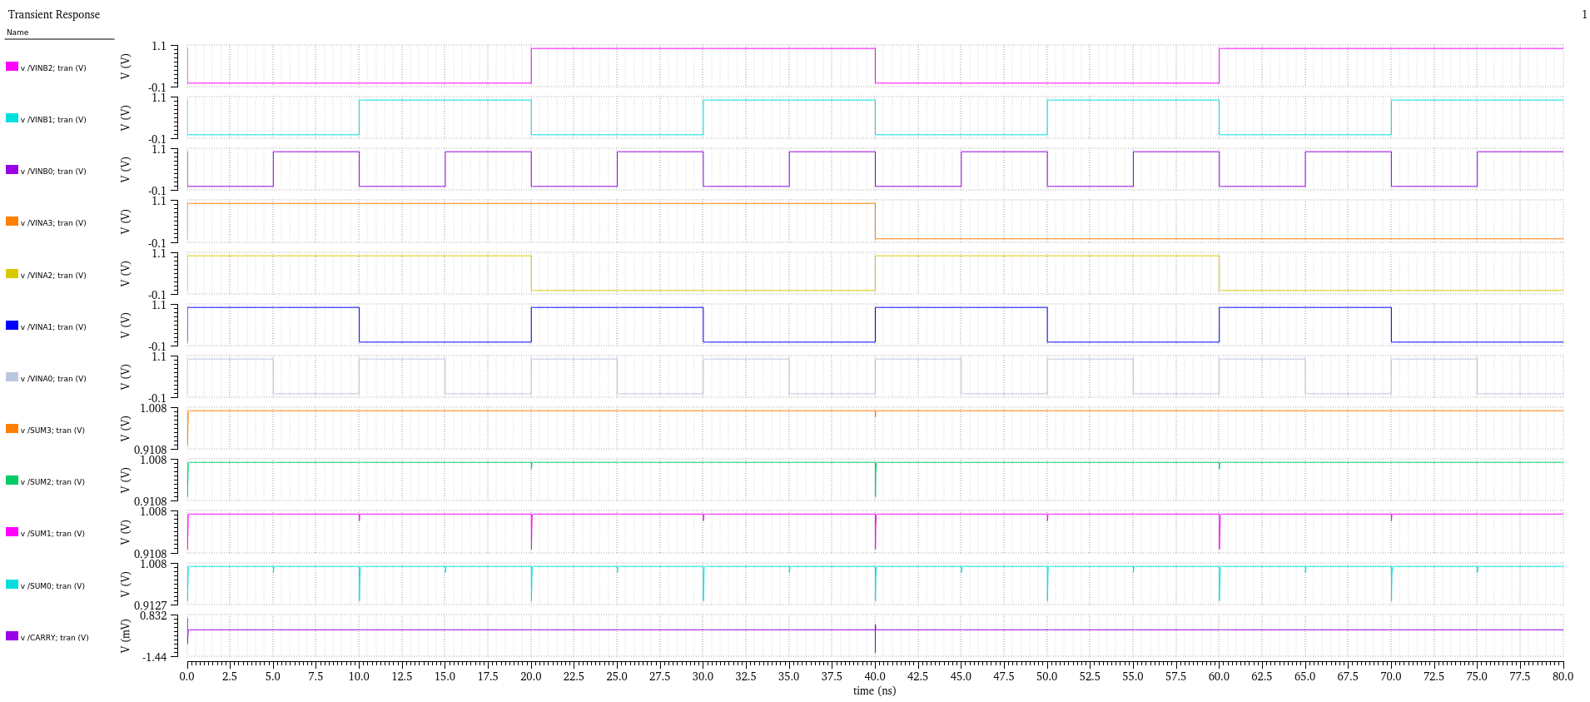
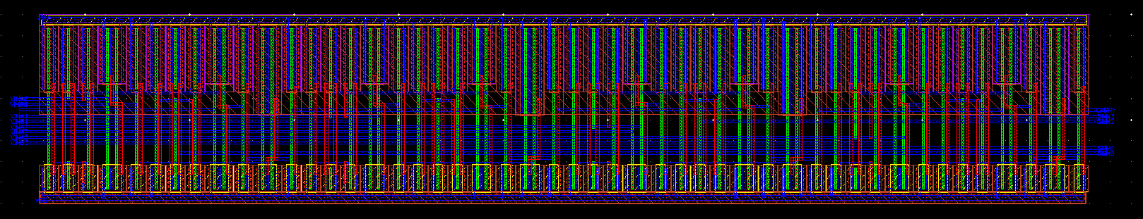
Digital Circuit – 4BIT_ADDER
Schematic |  | Layout | Simulation
Symbol |  | Hight = 9.05um Width = 50.16um | 1111 + 0000→ 1111 CARRY 0 0111+ 1000 → 1111 CARRY 0 1011+ 0100 → 1111 CARRY 0 1101+ 0010 → 1111 CARRY 0

Slide 20
Digital Circuit – ADDER
4BIT_ADDER_SUBTRACTOR
Digital circuit capable of performing both addition and subtraction of two 4-bit binary numbers.
Composed of multiple full adders & XOR gates arranged in a sequence
Examples
Input |  |  | Output
A | B | mode | Sum | Carry
1011 | 0110 | 0 | 0001 | 1
1010 | 0101 | 1 | 0101 | 1
0001 | 1100 | 1 | 1110 | 0
Notes:
HALF_ADDER / FULL_ADDER / 4BIT_ADDER

Slide 21




Digital Circuit4BIT_ADDER_SUBTRACTOR
Schematic |  | Layout | Simulation
Symbol |  | Hight = 9.05um Width = 61.44um | 1111 – 1111 → 0000 CARRY 1 0101 - 0101 → 0000 CARRY 1 1111+ 1111 → 1110 CARRY 1 0111+ 0111 → 1110 CARRY 0

Slide 22

CONTACT
Email
kim0607118@naver.com
Phone
010.8331.7683

